Slide 1
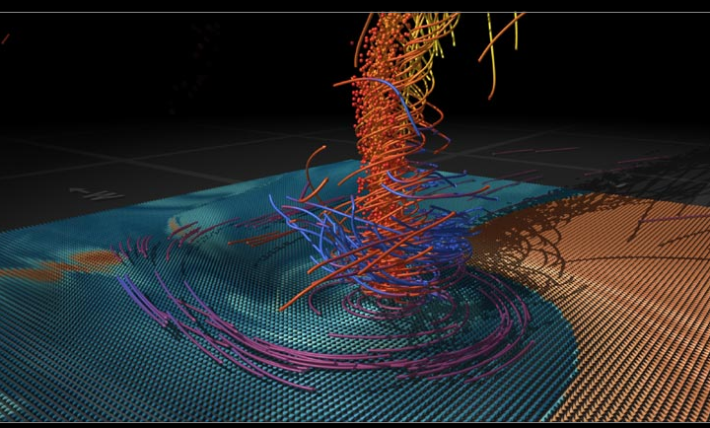
PHYS 8750 Numerical Fluid Dynamics
Fall 2020
Hunt for the supertwister – pbs.org/nova/tornado

Slide 2
PHYS 8750
Outline
Criteria to evaluate Stability; accuracy; convergence; consistency
1) Truncation errors & order of accuracy
2) A-stability and stability diagram
3) Amplitude and phase error
Class #1 (Chapter 1.1) 1) Terminology
ODE vs. PDE
Order of PDE
Linear vs. nonlinear
Types of equations
2) Numerical Scheme
Forward/backward/leapfrog
Upstream/downstream/center space
Class #2 (Chapter 2.1, 2.2)

Slide 3
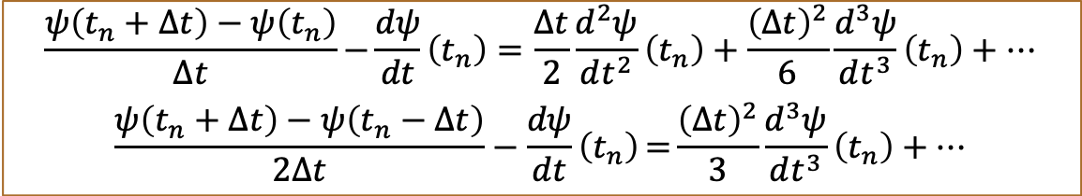
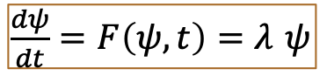
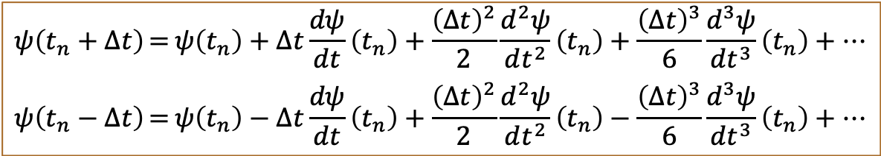
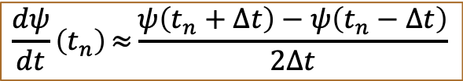
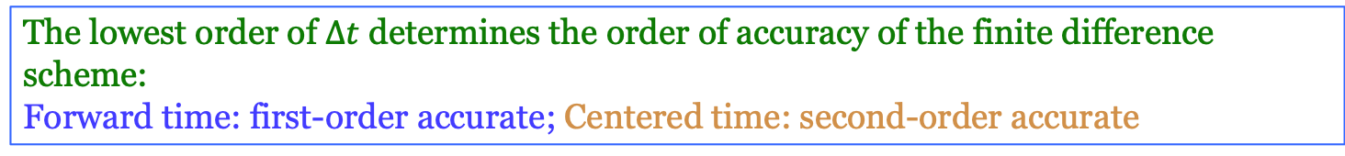
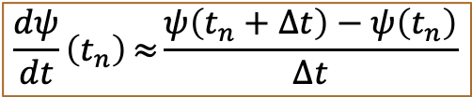
Truncation Error & Order of Accuracy
1-D TRANSPORT ODE
$\frac{dψ}{dt}=F\left(ψ,t\right)=λ$ $ψ$
Centered
time
Forward
time
$$\frac{dψ}{dt}\left(t_{n}\right)≈{\frac{ψ\left(t_{n}+∆t\right)−ψ\left(t_{n}\right)}{∆t}}$$
$$\frac{dψ}{dt}\left(t_{n}\right)≈{\frac{ψ\left(t_{n}+∆t\right)−ψ\left(t_{n}−∆t\right)}{2∆t}}$$
$$ψ\left(t_{n}+∆t\right)={ψ\left(t_{n}\right)+∆t\frac{dψ}{dt}\left(t_{n}\right)+\frac{{\left(∆t\right)}^{2}}{2}\frac{d^{2}ψ}{dt^{2}}\left(t_{n}\right)+\frac{{\left(∆t\right)}^{3}}{6}\frac{d^{3}ψ}{dt^{3}}\left(t_{n}\right)+…}$$
$$ψ\left(t_{n}−∆t\right)={ψ\left(t_{n}\right)−∆t\frac{dψ}{dt}\left(t_{n}\right)+\frac{{\left(∆t\right)}^{2}}{2}\frac{d^{2}ψ}{dt^{2}}\left(t_{n}\right)−\frac{{\left(∆t\right)}^{3}}{6}\frac{d^{3}ψ}{dt^{3}}\left(t_{n}\right)+…}$$
Taylor Expansion:
$$\frac{ψ\left(t_{n}+∆t\right)−ψ\left(t_{n}\right)}{∆t}−{\frac{dψ}{dt}\left(t_{n}\right)=\frac{∆t}{2}\frac{d^{2}ψ}{dt^{2}}\left(t_{n}\right)+\frac{{\left(∆t\right)}^{2}}{6}\frac{d^{3}ψ}{dt^{3}}\left(t_{n}\right)+…}$$
$$\frac{ψ\left(t_{n}+∆t\right)−ψ\left(t_{n}−∆t\right)}{2∆t}−\frac{dψ}{dt}\left(t_{n}\right)={\frac{{\left(∆t\right)}^{2}}{3}\frac{d^{3}ψ}{dt^{3}}\left(t_{n}\right)+…}$$
Truncation Error
The lowest order of $∆t$ determines the order of accuracy of the finite difference scheme:
Forward time: first-order accurate; Centered time: second-order accurate

Slide 4
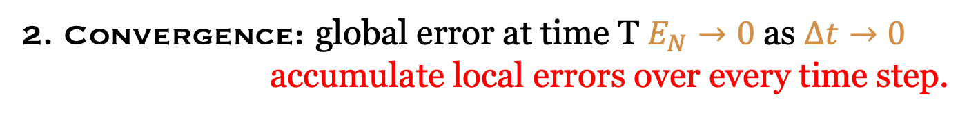
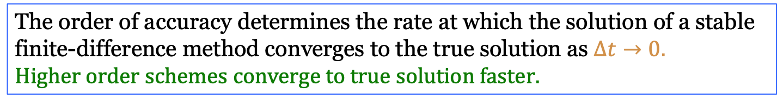
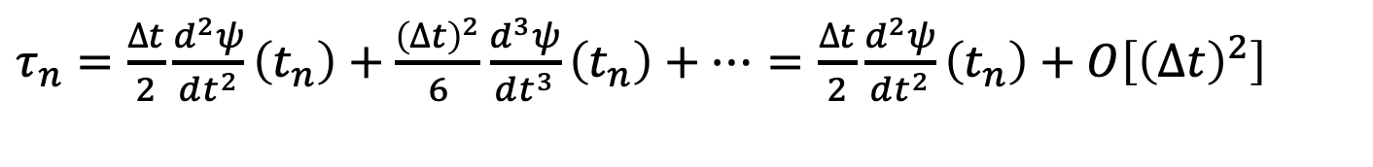
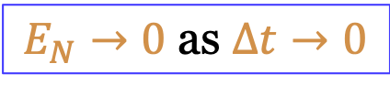

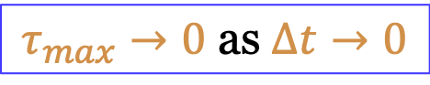
Consistency and Convergence
1. Consistency: truncation error $τ_{n}→0$ as $∆t→0$
Forward time
$τ_{n}{=\frac{∆t}{2}\frac{d^{2}ψ}{dt^{2}}\left(t_{n}\right)+\frac{{\left(∆t\right)}^{2}}{6}\frac{d^{3}ψ}{dt^{3}}\left(t_{n}\right)+…}$ $=$ $\frac{∆t}{2}\frac{d^{2}ψ}{dt^{2}}\left(t_{n}\right)+O\left[{\left(∆t\right)}^{2}\right]$
$$τ_{n}={\frac{{\left(∆t\right)}^{2}}{3}\frac{d^{3}ψ}{dt^{3}}\left(t_{n}\right)+O\left[{\left(∆t\right)}^{3}\right]}$$
Centered time
2. Convergence: global error at time T $E_{N}→0$ as $∆t→0$
accumulate local errors over every time step.
Forward time
$E_{N}≤N∆t{\left(1+\left|λ\right|∆t\right)}^{N}$ $τ_{max}≤Te^{\left|λ\right|T}τ_{max}$
$$τ_{max}→0 \text{as} ∆t→0$$
$$E_{N}→0 \text{as} ∆t→0$$
The order of accuracy determines the rate at which the solution of a stable finite-difference method converges to the true solution as $∆t→0.$
$$Higher order schemes converge to true solution faster.$$

Slide 5
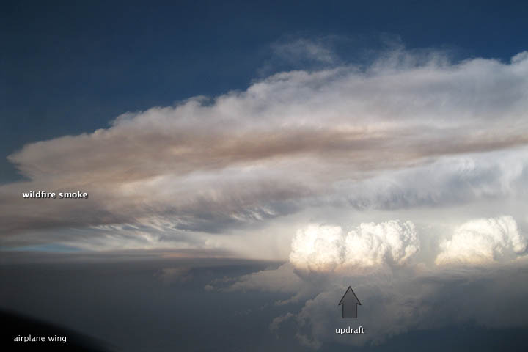
Examples of instability in nature
Thunderstorms
From
Aircraft
Location
Wyoming
Duration
hours
Date
7/11/2012
Credit
DC3 project
earthobservatory.nasa.gov/IOTD/view.php?id=78497 smoke from Colorado fire
A.009: Instability (physical)

Slide 6
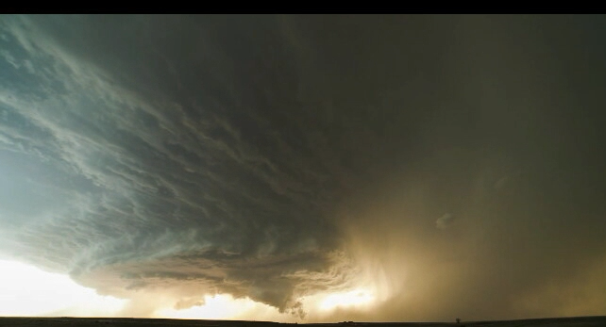
Examples of instability in nature
Thunderstorms
From
Ground
Location
Booker TX
Duration
hours
Date
6/3/2013
Credit
Mike Oblinski
Instability has been defined as "outputs of internal states growing without bounds" or "if small perturbations cause changes that reinforce the original perturbation"
A.009: Instability (physical)

Slide 7
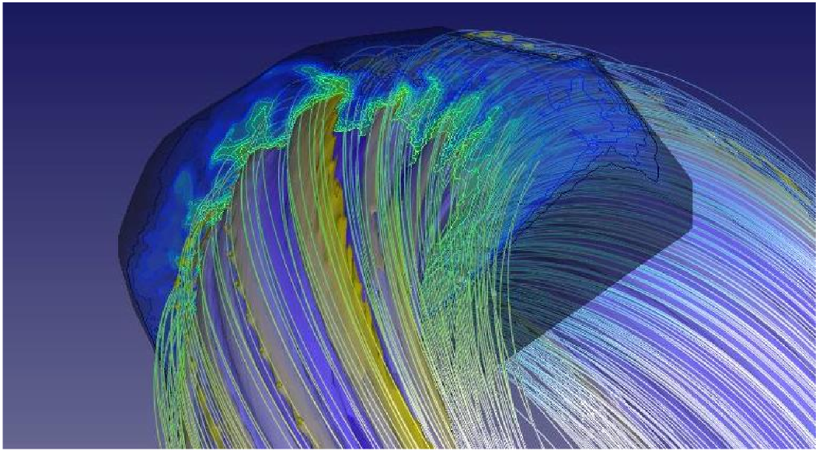
Examples of instability in nature
Nonlinear instability in toroidal fusion plasma
From:
Simulation
Location:
Nat’l Energy Research Scientific Computing Center (NERSC)
Credit
MIT: Linda Sugiyama
The extended magnetohydrodynamics (MHD) code M3D was used to study magnetic confinement and stability properties of fusion plasma in a Tokamak. Edge Localized Modes were noted, a new class of plasma instability.
Ref: www.nersc.gov/science/fusion-science/a-new-class-of-tokamak-nonlinear-plasma-instability/
A.009: Instability (physical)

Slide 8
Stability: computational perspective
What is stability?
Let’s work backwards. What is instability?
Instability
Unstable numerical scheme: numerical solution grows much more rapidly than the true one
What is “more rapidly?”
We must be knowledgeable of the PDE properties (and thus of the physical phenomenon) to assess reasonable behavior.
If amplitude should not change –
any continued growth in the numerical solution is unstable
If exponential growth in amplitude is possible
than any growth beyond that is considered a numerical instability.
Notes:
http://cnx.org/content/m0041/latest/ discusses how Fourier series cannot be used (with the strict equality) for a discontinuity; doing so invokes the Gibbs phenomenon. While the rms error of the Fourier series goes to zero for an infinite number of terms, equality at every point is not guaranteed; the Gibbs phenomenon peaks “have finite height and zero width.” Coefficients in a truncated Fourier series can be used to reduce or eliminate the Gibbs effect; see http://www.jhu.edu/~signals/phasorlecture2/indexphasorlect2.htm for more on these windowing methods.

Slide 9
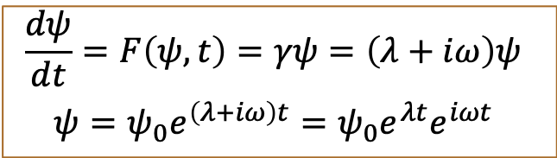
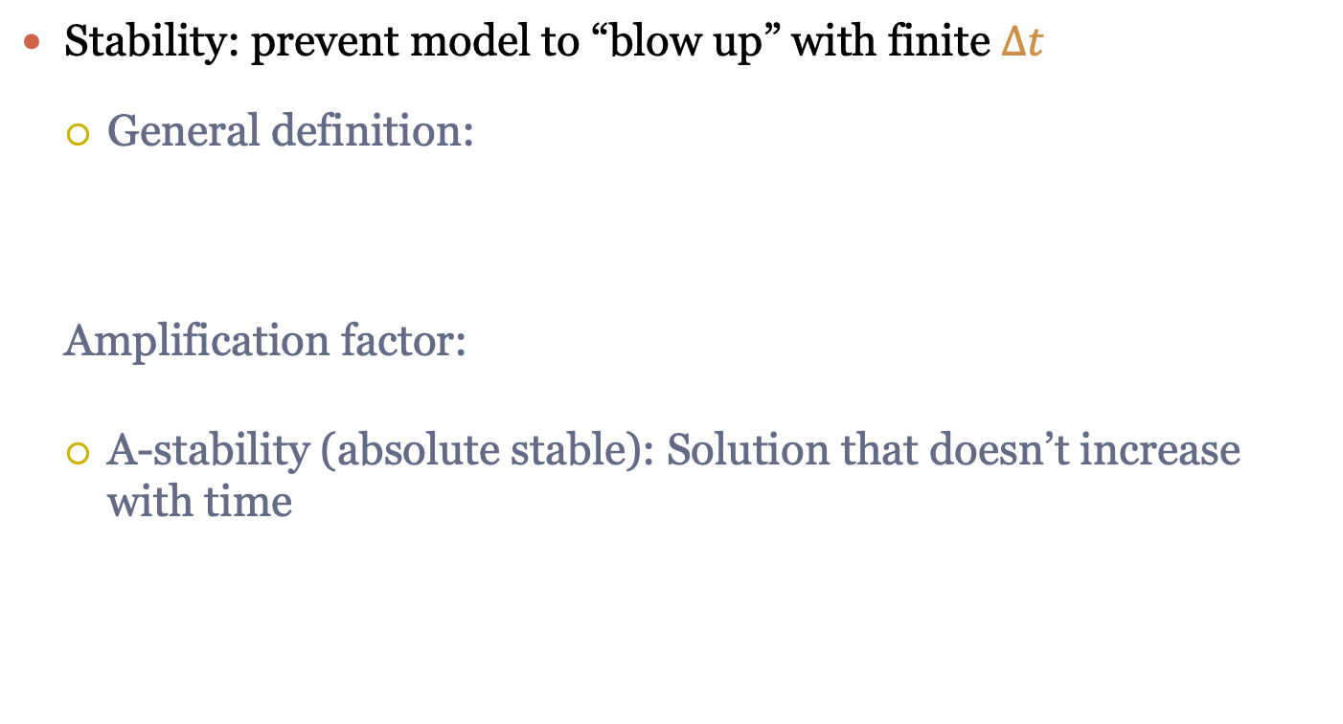
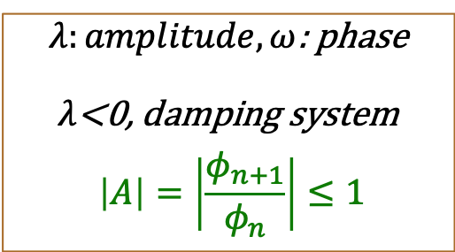
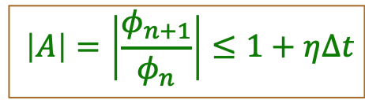
Stability
To make model really run reasonably, consistency and convergence are not enough, because $∆t→0$ is an idealized case.
Stability: prevent model to “blow up” with finite $∆t$
General definition:
Amplification factor:
A-stability (absolute stable): Solution that doesn’t increase with time
$$φ_{n}:numerical solution of ψ at time step n+1$$
$$\left|A\right|=\left|\frac{φ_{n+1}}{φ_{n}}\right|≤1+η∆t$$
$λ:amplitude, ω$: phase
$λ$<0, damping system
$$\left|A\right|=\left|\frac{φ_{n+1}}{φ_{n}}\right|≤1$$
$$\frac{dψ}{dt}=F\left(ψ,t\right)=γψ=\left(λ+iω\right)ψ$$
$$ψ=ψ_{0}e^{\left(λ+iω\right)t}=ψ_{0}e^{λt}e^{iωt}$$

Slide 10
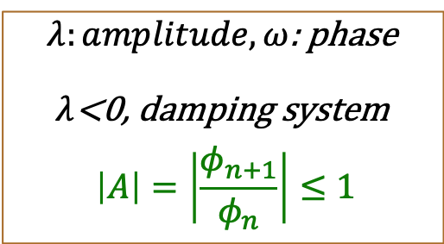
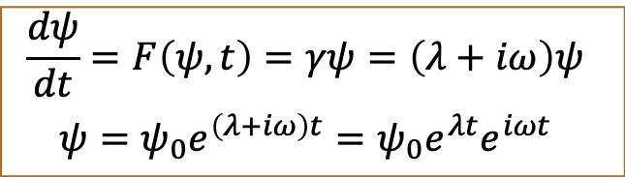
A-Stability
$$\frac{dψ}{dt}=F\left(ψ,t\right)=γψ=\left(λ+iω\right)ψ$$
$$ψ=ψ_{0}e^{\left(λ+iω\right)t}=ψ_{0}e^{λt}e^{iωt}$$
$λ:amplitude, ω$: phase
$λ$<0, damping system
$$\left|A\right|=\left|\frac{φ_{n+1}}{φ_{n}}\right|≤1$$
Forward time difference
$$\frac{φ_{n+1}−φ_{n}}{∆t}=\left(λ+iω\right)φ_{n}⟹φ_{n+1}=\left[1+\left(λ+iω\right)∆t\right]φ_{n}$$
$\left|A\right|=\left|\frac{φ_{n+1}}{φ_{n}}\right| =\left|1+\left(λ+iω\right)∆t\right|$ $≤1⟹{\left(1+λ∆t\right)}^{2}+{\left(ω∆t\right)}^{2}$ $≤1$
${1+2λ∆t+\left(λ^{2}+ω^{2}\right)\left(∆t\right)}^{2} ≤1⟹∆t$ $≤\frac{−2λ}{\left(λ^{2}+ω^{2}\right)}$

Slide 11
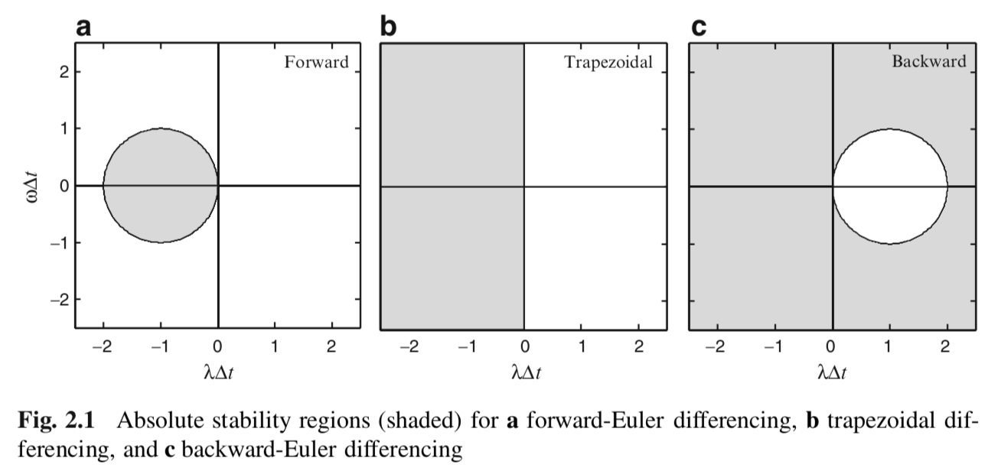
A-Stability
$\left|A\right|=\left|\frac{φ_{n+1}}{φ_{n}}\right| =\left[1+\left(λ+iω\right)\right]$ $≤1⟹{\left(1+λ∆t\right)}^{2}+{\left(ω∆t\right)}^{2}$ $≤1$

Slide 12
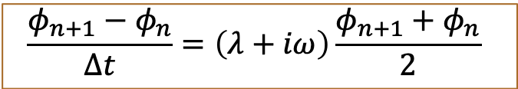
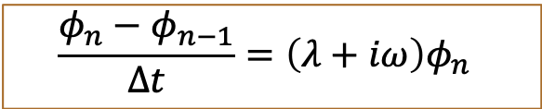
A-Stability
Backward time
$$\frac{φ_{n}−φ_{n−1}}{∆t}=\left(λ+iω\right)φ_{n}$$
Trapezoidal
$$\frac{φ_{n+1}−φ_{n}}{∆t}=\left(λ+iω\right)\frac{φ_{n+1}+φ_{n}}{2}$$

Slide 13
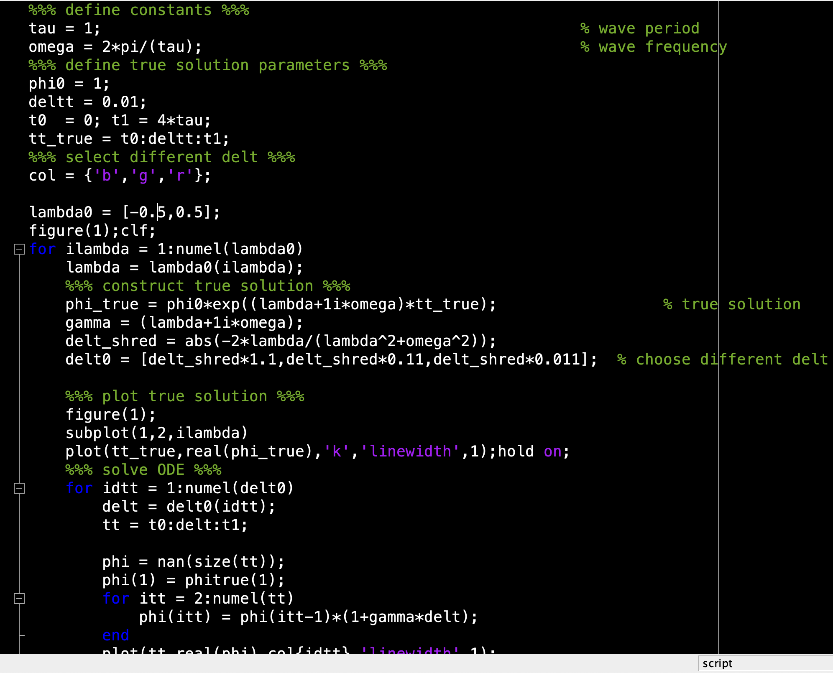
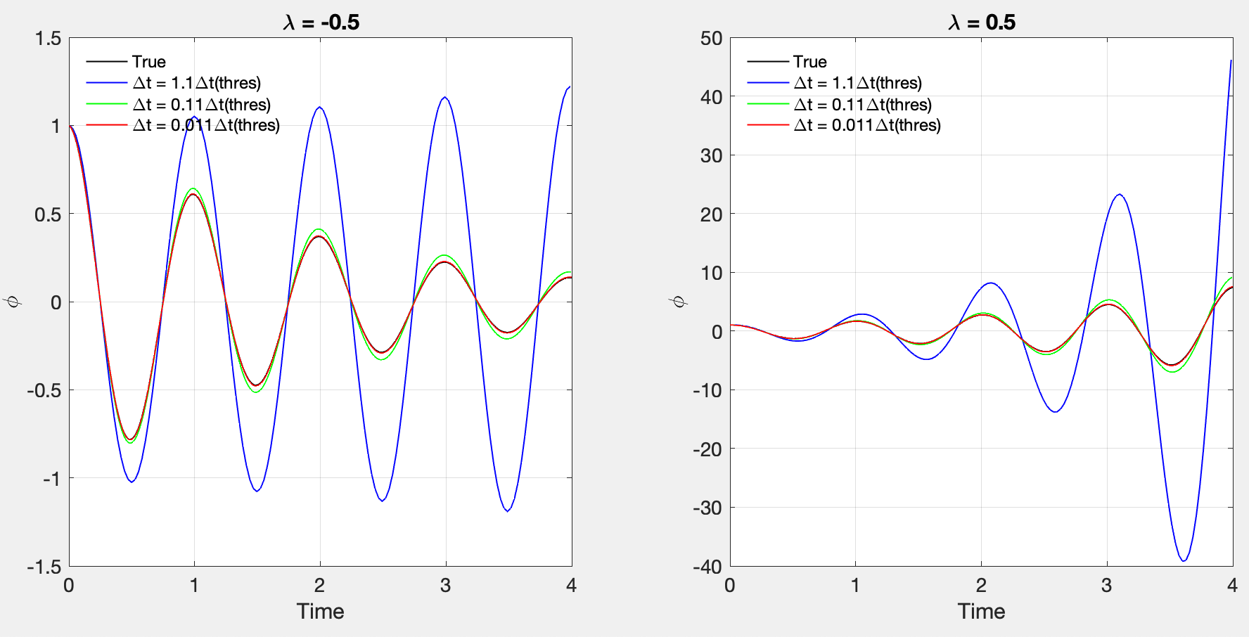
Matlab Code-Forward Time

Slide 14
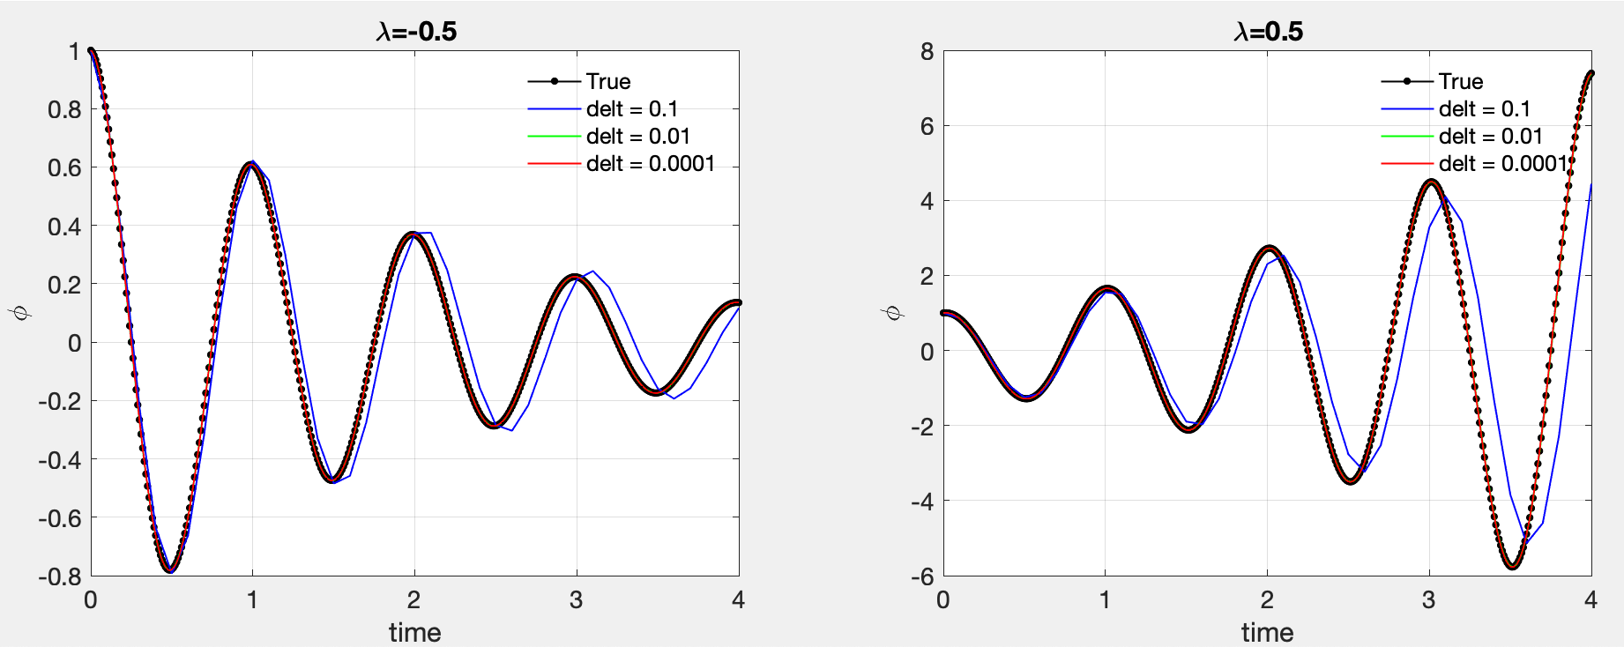
Trapezoidal
Trapezoidal method is less critical to $∆t$. But still, all show amplitude and phase errors compared with true solutions. How to quantify these errors?

Slide 15
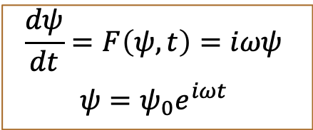
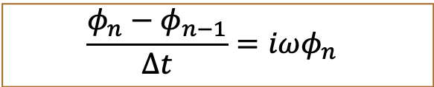

Amplitude Error
$$\frac{dψ}{dt}=F\left(ψ,t\right)=iωψ$$
$$ψ=ψ_{0}e^{iωt}$$
Oscillation Equation
$${\left|A\right|}_{real}=1$$
Forward time
$A=\frac{φ_{n+1}}{φ_{n}}=\left[1+\left(iω∆t\right)\right]$ $⟹\left|A\right|=$ $\sqrt{1+{\left(ω∆t\right)}^{2}}≈1+{\frac{1}{2}\left(ω∆t\right)}^{2}≥1$
$$\frac{φ_{n}−φ_{n−1}}{∆t}=iωφ_{n}$$
Backward time
$$A =\frac{φ_{n}}{φ_{n−1}}=\frac{1}{1−\left(iω∆t\right)}⟹{\left|A\right|=\left(1+{\left(ω∆t\right)}^{2}\right)}^{−\frac{1}{2}}=1−{\frac{1}{2}\left(ω∆t\right)}^{2}≤1$$

Slide 16
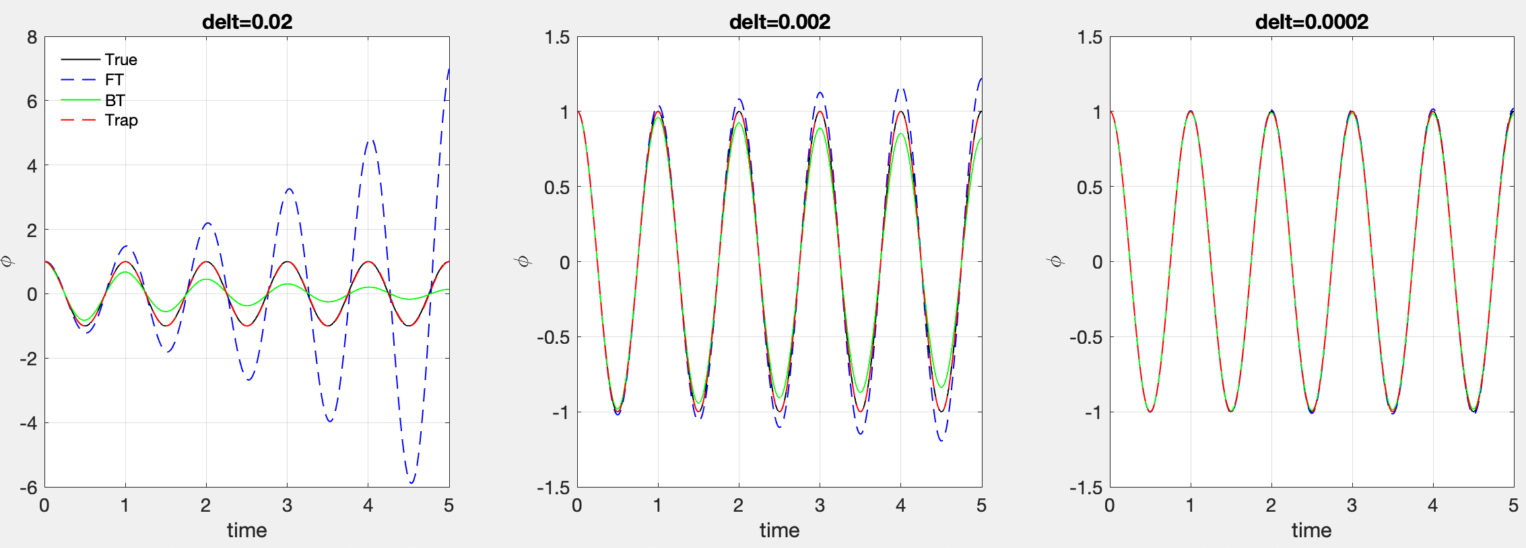
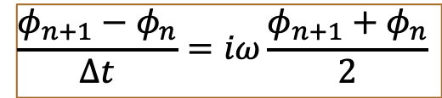
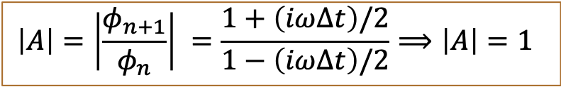
Amplitude Error
Trapezoidal
$$\frac{φ_{n+1}−φ_{n}}{∆t}=iω\frac{φ_{n+1}+φ_{n}}{2}$$
$$\left|A\right|=\left|\frac{φ_{n+1}}{φ_{n}}\right| =\frac{1+\left(iω∆t\right)/2}{1−\left(iω∆t\right)/2}⟹\left|A\right|=1$$
Forward scheme amplifies, while backward scheme damps solution.
Amp errors increase with larger $∆t$. Trapezoidal scheme is free of amp error.

Slide 17
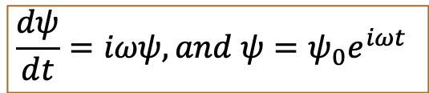
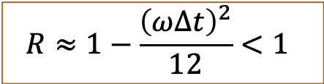
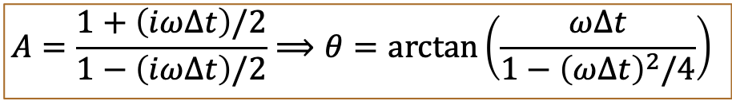
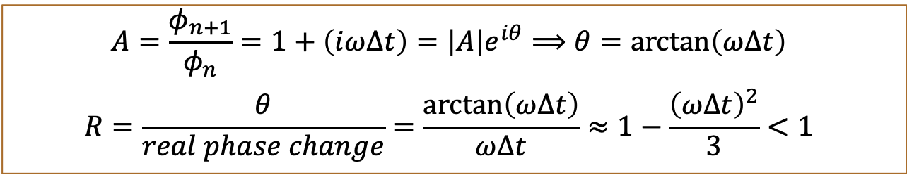

Phase Error
Real Phase Evolution
$$\frac{dψ}{dt}=iωψ, and ψ=ψ_{0}e^{iωt}$$
$$ψ(t+∆t)=ψ(t)e^{iω∆t}$$
Forward time
$$A=\frac{φ_{n+1}}{φ_{n}}=1+\left(iω∆t\right)=\left|A\right|e^{iθ}⟹θ=\arctan\left(ω∆t\right)$$
$$R=\frac{θ}{real phase change}=\frac{\arctan\left(ω∆t\right)}{ω∆t}≈1−\frac{{\left(ω∆t\right)}^{2}}{3}<1$$
Trapezoidal
$$A=\frac{1+\left(iω∆t\right)/2}{1−\left(iω∆t\right)/2}⟹θ=\arctan\left(\frac{ω∆t}{1−{\left(ω∆t\right)}^{2}/4}\right)$$
$$R≈1−\frac{{\left(ω∆t\right)}^{2}}{12}<1$$
All two-level schemes will delay the phase of true solution. The deceleration by trapezoidal is one quarter of that by forward and backward schemes.

Slide 18
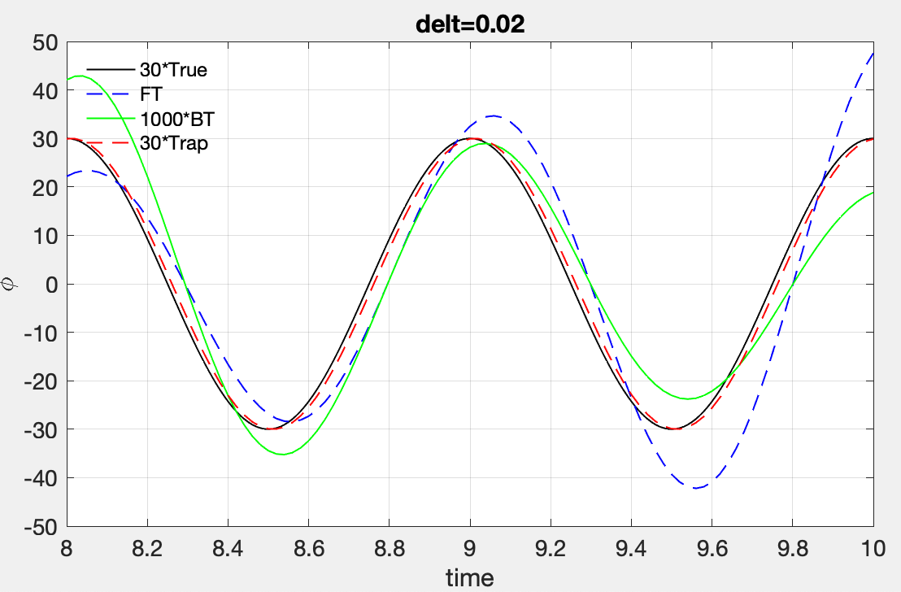
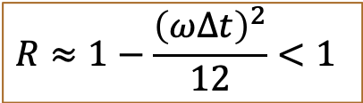
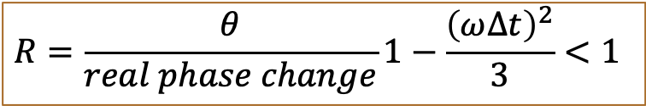
Phase Error
Forward time
Trapezoidal
$$R=\frac{θ}{real phase change}1−\frac{{\left(ω∆t\right)}^{2}}{3}<1$$
$$R≈1−\frac{{\left(ω∆t\right)}^{2}}{12}<1$$
All two-level schemes will delay the phase of true solution. The deceleration by trapezoidal is less than that by forward and backward schemes.

